Slide 1
Hash tables

Slide 2
Hash tables
Hash table (hash map) is a data structure that implements an associative array abstract data type, a structure that can map keys to values.
A hash table uses a hash function to compute an index, also called a hash code, into an array of buckets or slots, from which the desired value can be found.
Hash tables are a common approach to the storing/searching problem.
There are only 3 operations, that we can perform on hash tables:
Adding, finding and removing the elements.

Slide 3

Hash tables Inner representation
A hash tables usually contains an array of list/array/tree of $records$.
hash | 0 | 1 | 2 | 3 | 4 | 5 | 6 | 7 | 8 | 9 | 10 | 11 | 12 | 13 | 14 | 15 | 16 | 17 | 18
obj1
obj2
obj3
obj4
obj5
obj6
obj7
obj8
obj9
obj10
obj11
obj12
obj13
obj14

Slide 4
Hash tables Collisions
Why we need an array of arrays/lists/trees?
Because some of the elements hashes may be the same.
We need some technique to handle the different elements with the same hash.
Or simply store all the elements, and after given element hash calculating check all the elements with same hash.

Slide 5

Hash tables Operations: Add element
For a given element $x$ need to find $h=hash\left(x\right).$
Push back/insert element $x$ in the array/list/tree under the index $h$.

Slide 6

Hash tables Operations: Find element
For a given element $x$ need to find $h=hash\left(x\right).$
Then iterate over all the elements under the index $h$ and check given element presence.

Slide 7

Hash tables Operations: Delete element
For a given element $x$ need to find $h=hash\left(x\right).$
Then iterate over all the elements under the index $h$ and remove given element if it present. Otherwise do nothing.

Slide 8

Hash tables Example
Suppose that internal array size is equal to 20:
Let’s add some element $a$:
So let’s suppose $hash\left(a\right)=2$.
hash | 0 | 1 | 2 | 3 | 4 | 5 | 6 | 7 | 8 | 9 | 10 | 11 | 12 | 13 | 14 | 15 | 16 | 17 | 18 | 19

Slide 9
Hash tables Example
Suppose that internal array size is equal to 20:
Let’s add some element $a$:
So let’s suppose $hash\left(a\right)=2$.
hash | 0 | 1 | 2 | 3 | 4 | 5 | 6 | 7 | 8 | 9 | 10 | 11 | 12 | 13 | 14 | 15 | 16 | 17 | 18 | 19
a

Slide 10

Hash tables Example
Suppose that internal array size is equal to 20:
Let’s add some element $b$:
So let’s suppose $hash\left(b\right)=6$.
hash | 0 | 1 | 2 | 3 | 4 | 5 | 6 | 7 | 8 | 9 | 10 | 11 | 12 | 13 | 14 | 15 | 16 | 17 | 18 | 19
a

Slide 11
Hash tables Example
Suppose that internal array size is equal to 20:
Let’s add some element $b$:
So let’s suppose $hash\left(b\right)=6$.
hash | 0 | 1 | 2 | 3 | 4 | 5 | 6 | 7 | 8 | 9 | 10 | 11 | 12 | 13 | 14 | 15 | 16 | 17 | 18 | 19
a
b

Slide 12

Hash tables Example
Suppose that internal array size is equal to 20:
Let’s add some element $c$:
So let’s suppose $hash\left(c\right)=15$.
hash | 0 | 1 | 2 | 3 | 4 | 5 | 6 | 7 | 8 | 9 | 10 | 11 | 12 | 13 | 14 | 15 | 16 | 17 | 18 | 19
a
b

Slide 13
Hash tables Example
Suppose that internal array size is equal to 20:
Let’s add some element $c$:
So let’s suppose $hash\left(c\right)=15$.
hash | 0 | 1 | 2 | 3 | 4 | 5 | 6 | 7 | 8 | 9 | 10 | 11 | 12 | 13 | 14 | 15 | 16 | 17 | 18 | 19
a
b
c

Slide 14

Hash tables Example
Suppose that internal array size is equal to 20:
Let’s add some element $d$:
So let’s suppose $hash\left(d\right)=6$.
hash | 0 | 1 | 2 | 3 | 4 | 5 | 6 | 7 | 8 | 9 | 10 | 11 | 12 | 13 | 14 | 15 | 16 | 17 | 18 | 19
a
b
c

Slide 15
Hash tables Example
Suppose that internal array size is equal to 20:
Let’s add some element $d$:
So let’s suppose $hash\left(d\right)=6$.
hash | 0 | 1 | 2 | 3 | 4 | 5 | 6 | 7 | 8 | 9 | 10 | 11 | 12 | 13 | 14 | 15 | 16 | 17 | 18 | 19
a
b
c
d

Slide 16

Hash tables Example
Suppose that internal array size is equal to 20:
Let’s check some element $e$ presence:
So let’s suppose $hash\left(e\right)=7$.
hash | 0 | 1 | 2 | 3 | 4 | 5 | 6 | 7 | 8 | 9 | 10 | 11 | 12 | 13 | 14 | 15 | 16 | 17 | 18 | 19
a
b
c
d

Slide 17

Hash tables Example
Suppose that internal array size is equal to 20:
Let’s check some element $e$ presence:
So let’s suppose $hash\left(e\right)=7$.
There are no elements with hash equals to 7, so answer is No.
hash | 0 | 1 | 2 | 3 | 4 | 5 | 6 | 7 | 8 | 9 | 10 | 11 | 12 | 13 | 14 | 15 | 16 | 17 | 18 | 19
a
b
c
d

Slide 18

Hash tables Example
Suppose that internal array size is equal to 20:
Let’s check some element $f$ presence:
So let’s suppose $hash\left(f\right)=2$.
hash | 0 | 1 | 2 | 3 | 4 | 5 | 6 | 7 | 8 | 9 | 10 | 11 | 12 | 13 | 14 | 15 | 16 | 17 | 18 | 19
a
b
c
d

Slide 19

Hash tables Example
Suppose that internal array size is equal to 20:
Let’s check some element $f$ presence:
So let’s suppose $hash\left(f\right)=2$.
Need to check all the elements with hash 2, but still no result.
hash | 0 | 1 | 2 | 3 | 4 | 5 | 6 | 7 | 8 | 9 | 10 | 11 | 12 | 13 | 14 | 15 | 16 | 17 | 18 | 19
a
b
c
d

Slide 20

Hash tables Example
Suppose that internal array size is equal to 20:
Now let’s check presence of element $d$:
$hash\left(d\right)=6$.
hash | 0 | 1 | 2 | 3 | 4 | 5 | 6 | 7 | 8 | 9 | 10 | 11 | 12 | 13 | 14 | 15 | 16 | 17 | 18 | 19
a
b
c
d

Slide 21

Hash tables Example
Suppose that internal array size is equal to 20:
Now let’s check presence of element $d$:
$hash\left(d\right)=6$.
We need to iterate over all elements with hash 6, and this time we found needed element, so answer is Yes.
hash | 0 | 1 | 2 | 3 | 4 | 5 | 6 | 7 | 8 | 9 | 10 | 11 | 12 | 13 | 14 | 15 | 16 | 17 | 18 | 19
a
b
c
d

Slide 22

Hash tables Example
Suppose that internal array size is equal to 20:
Let’s remove some element $g$:
So let’s suppose $hash\left(g\right)=12$.
hash | 0 | 1 | 2 | 3 | 4 | 5 | 6 | 7 | 8 | 9 | 10 | 11 | 12 | 13 | 14 | 15 | 16 | 17 | 18 | 19
a
b
c
d

Slide 23

Hash tables Example
Suppose that internal array size is equal to 20:
Let’s remove some element $g$:
So let’s suppose $hash\left(g\right)=12$.
There are no elements with hash equals to 12, so do nothing.
hash | 0 | 1 | 2 | 3 | 4 | 5 | 6 | 7 | 8 | 9 | 10 | 11 | 12 | 13 | 14 | 15 | 16 | 17 | 18 | 19
a
b
c
d

Slide 24

Hash tables Example
Suppose that internal array size is equal to 20:
Let’s remove element $c$:
$hash\left(c\right)=15$.
hash | 0 | 1 | 2 | 3 | 4 | 5 | 6 | 7 | 8 | 9 | 10 | 11 | 12 | 13 | 14 | 15 | 16 | 17 | 18 | 19
a
b
c
d

Slide 25

Hash tables Example
Suppose that internal array size is equal to 20:
Let’s remove element $c$:
$hash\left(c\right)=15$.
We can find element by iterating over all elements, so we removing it.
hash | 0 | 1 | 2 | 3 | 4 | 5 | 6 | 7 | 8 | 9 | 10 | 11 | 12 | 13 | 14 | 15 | 16 | 17 | 18 | 19
a
b
c
d

Slide 26
Hash tables Example
Suppose that internal array size is equal to 20:
hash | 0 | 1 | 2 | 3 | 4 | 5 | 6 | 7 | 8 | 9 | 10 | 11 | 12 | 13 | 14 | 15 | 16 | 17 | 18 | 19
a
b
d

Slide 27
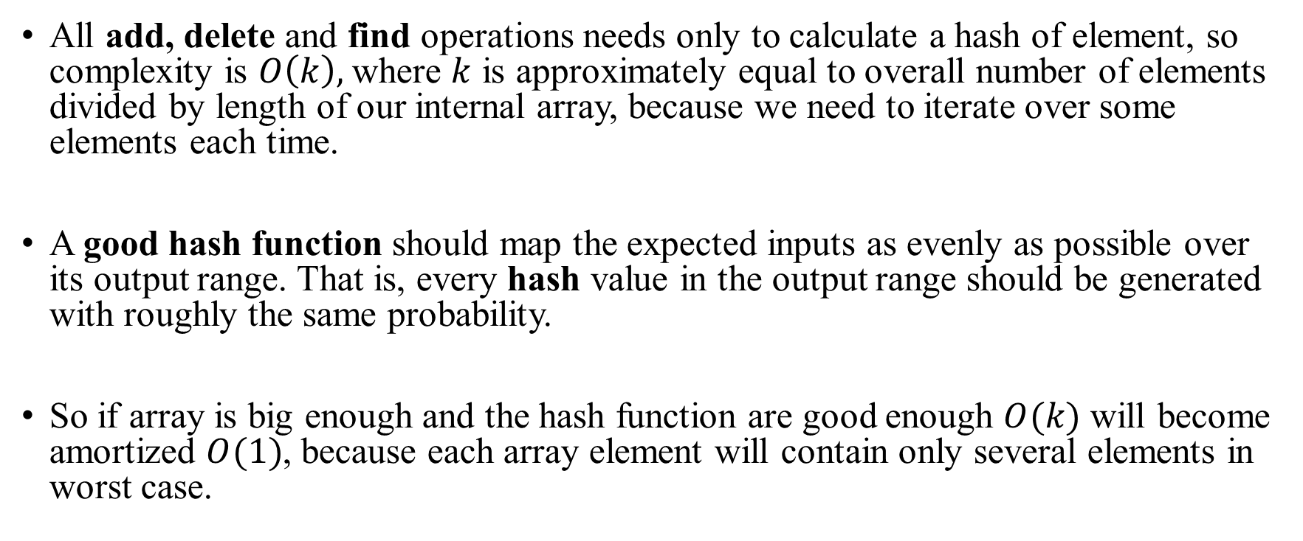
Hash tables Complexity
All add, delete and find operations needs only to calculate a hash of element, so complexity is $O\left(k\right),$where $k$ is approximately equal to overall number of elements divided by length of our internal array, because we need to iterate over some elements each time.
A good hash function should map the expected inputs as evenly as possible over its output range. That is, every hash value in the output range should be generated with roughly the same probability.
So if array is big enough and the hash function are good enough $O(k)$ will become amortized $O(1)$, because each array element will contain only several elements in worst case.

